Slide 1
Nutrition Counter - Team 7
Team Members
1. Harshita - 2023201002
2. Divyesh Patel - 2023201048
3. Hemanth Reddy - 2023201058
4. Ashish Lakhmani - 2023202008

Slide 2
Project Goals
Our primary goal is to create a user-friendly tool that extracts and analyzes nutrition data from food packaging images
The secondary objective involves using the extracted data to inform users about whether the food is nutritious or not

Slide 3
Overview
Account creation and login
Image type selection and upload
Data extraction and processing
Displaying Results - Nutrition Content and Recommendation
User history is also stored

Slide 4
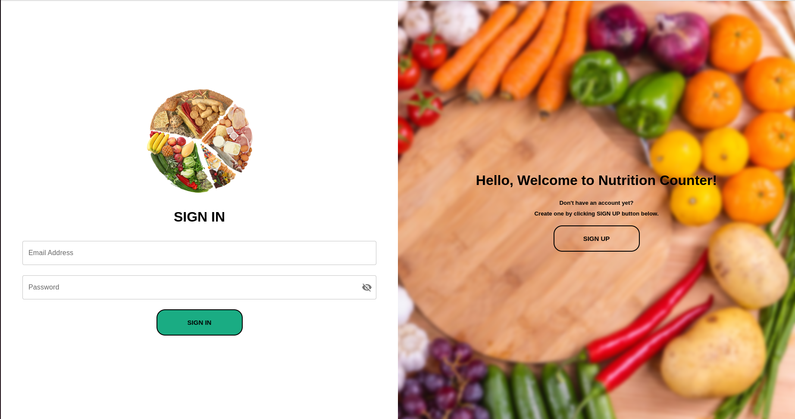
Account creation and login

Slide 5
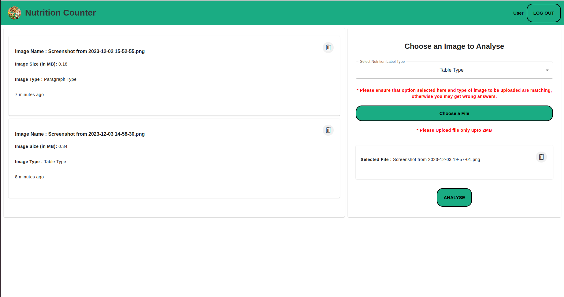
Image type selection, upload and User History

Slide 6
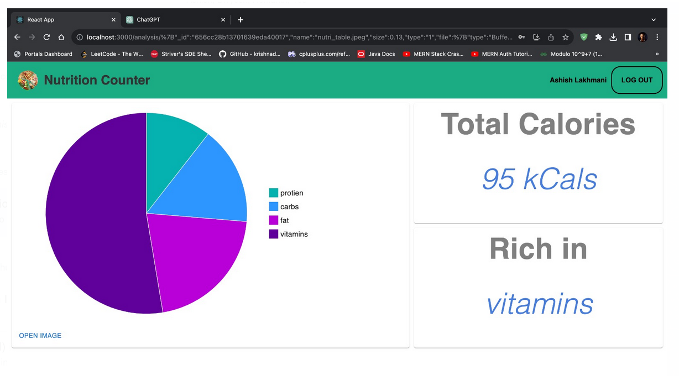
Displaying Results - Nutrition Content and Recommendation

Slide 7
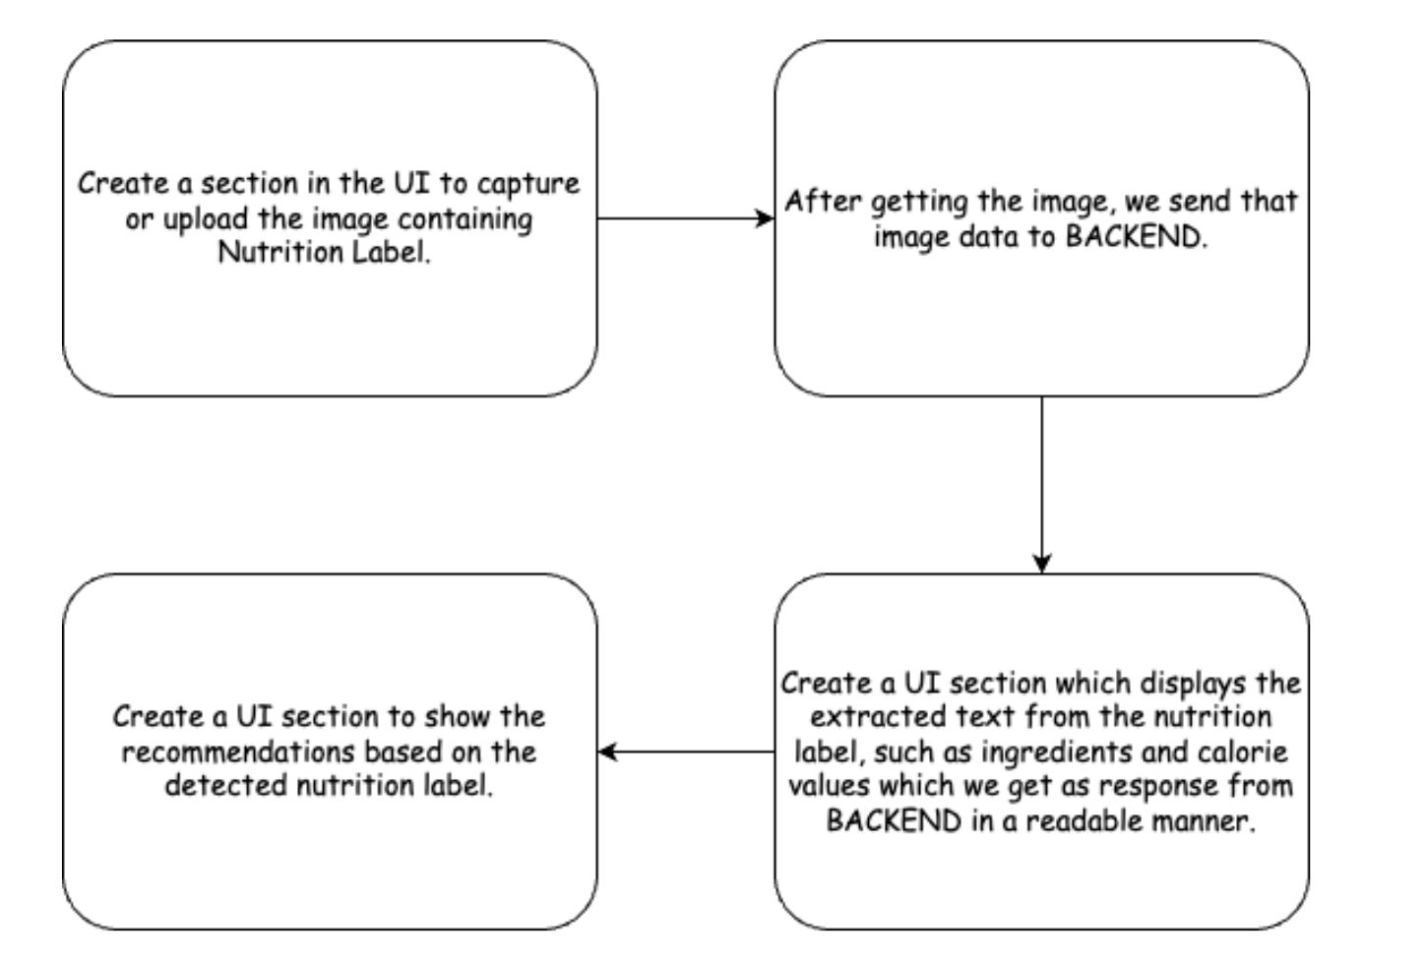
FlowCharts
1. Frontend :

Slide 8
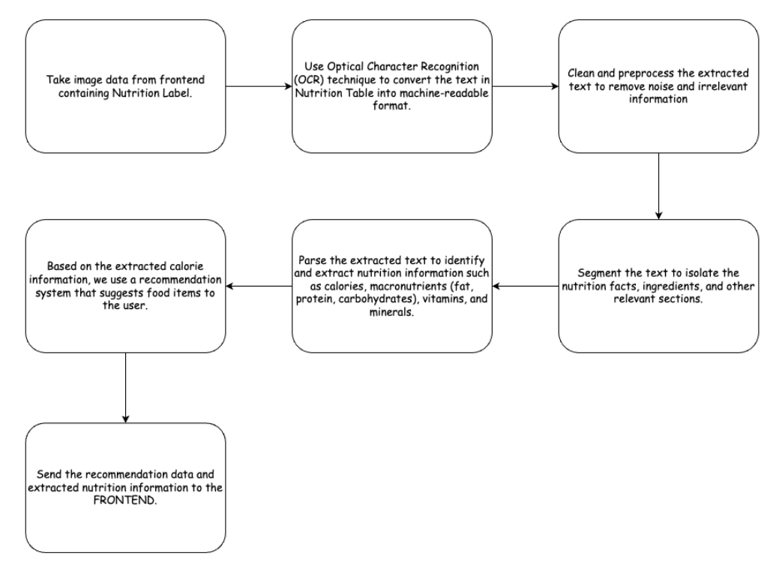
2. Backend :

Slide 9
Technologies Used
Data Extraction
Model Used - Tesseract
Front End
Used HTML, CSS and ReactJS
Back End
Python
DataBase
- MongoDB

Slide 10
Future Scope
Data Extraction
User Profile Enhancements
Offering multilingual support
Expand Visualization Support
Implement Feedback Mechanism

Slide 11
Thank You

